Slide 1







Over Brain
http://overbrain.herokuapp.com/

Slide 2



What is “Over Brain”?

Slide 3







Used technologies
Spring Boot
Spring Security
Mail Sending
Hibernate
Thymeleaf
PostgreSQL
Bootstrap

Slide 4

Code example from Project

Slide 5



Frontend Part

Slide 6
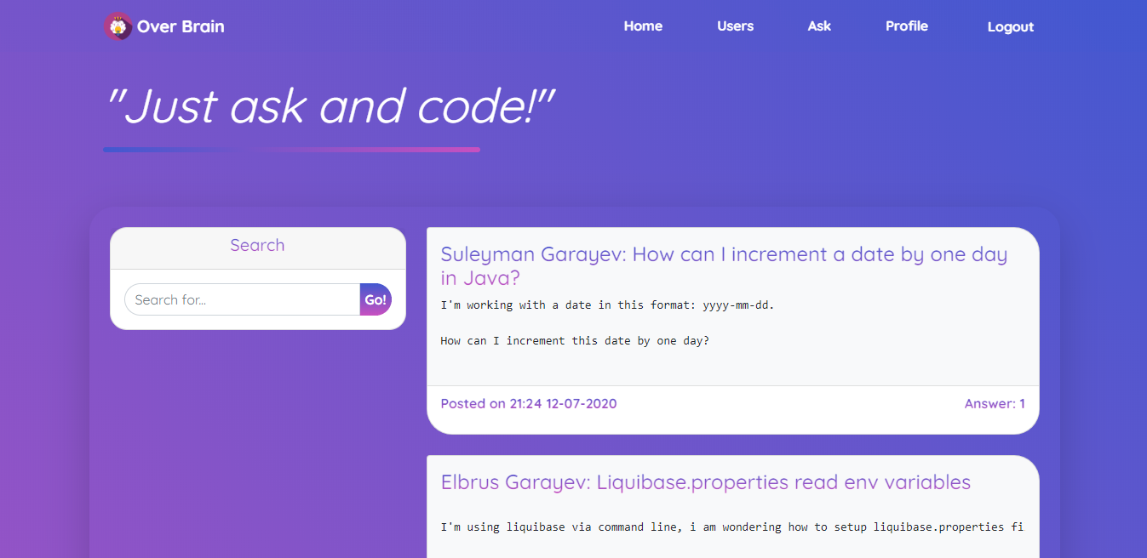
Desktop View

Slide 7
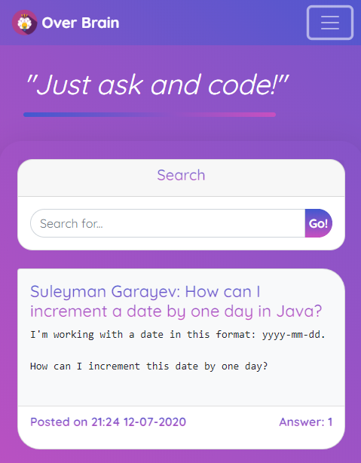
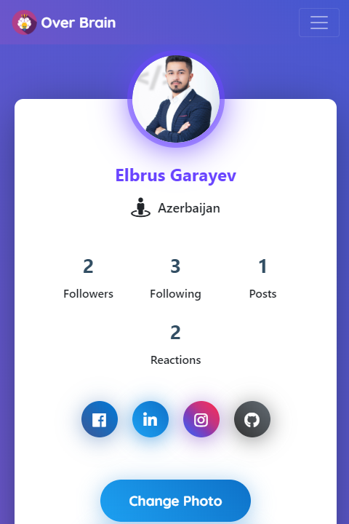
Mobile View

Slide 8
Coming soon!
Chat
OAuth2 login
Pagination
Follow/Unfollow improvements
And maybe things I'll think about later

Slide 9

Thanks!
Any questions?
You can find me at:
www.linkedin.com/in/elbrus-qarayev/

